Slide 1
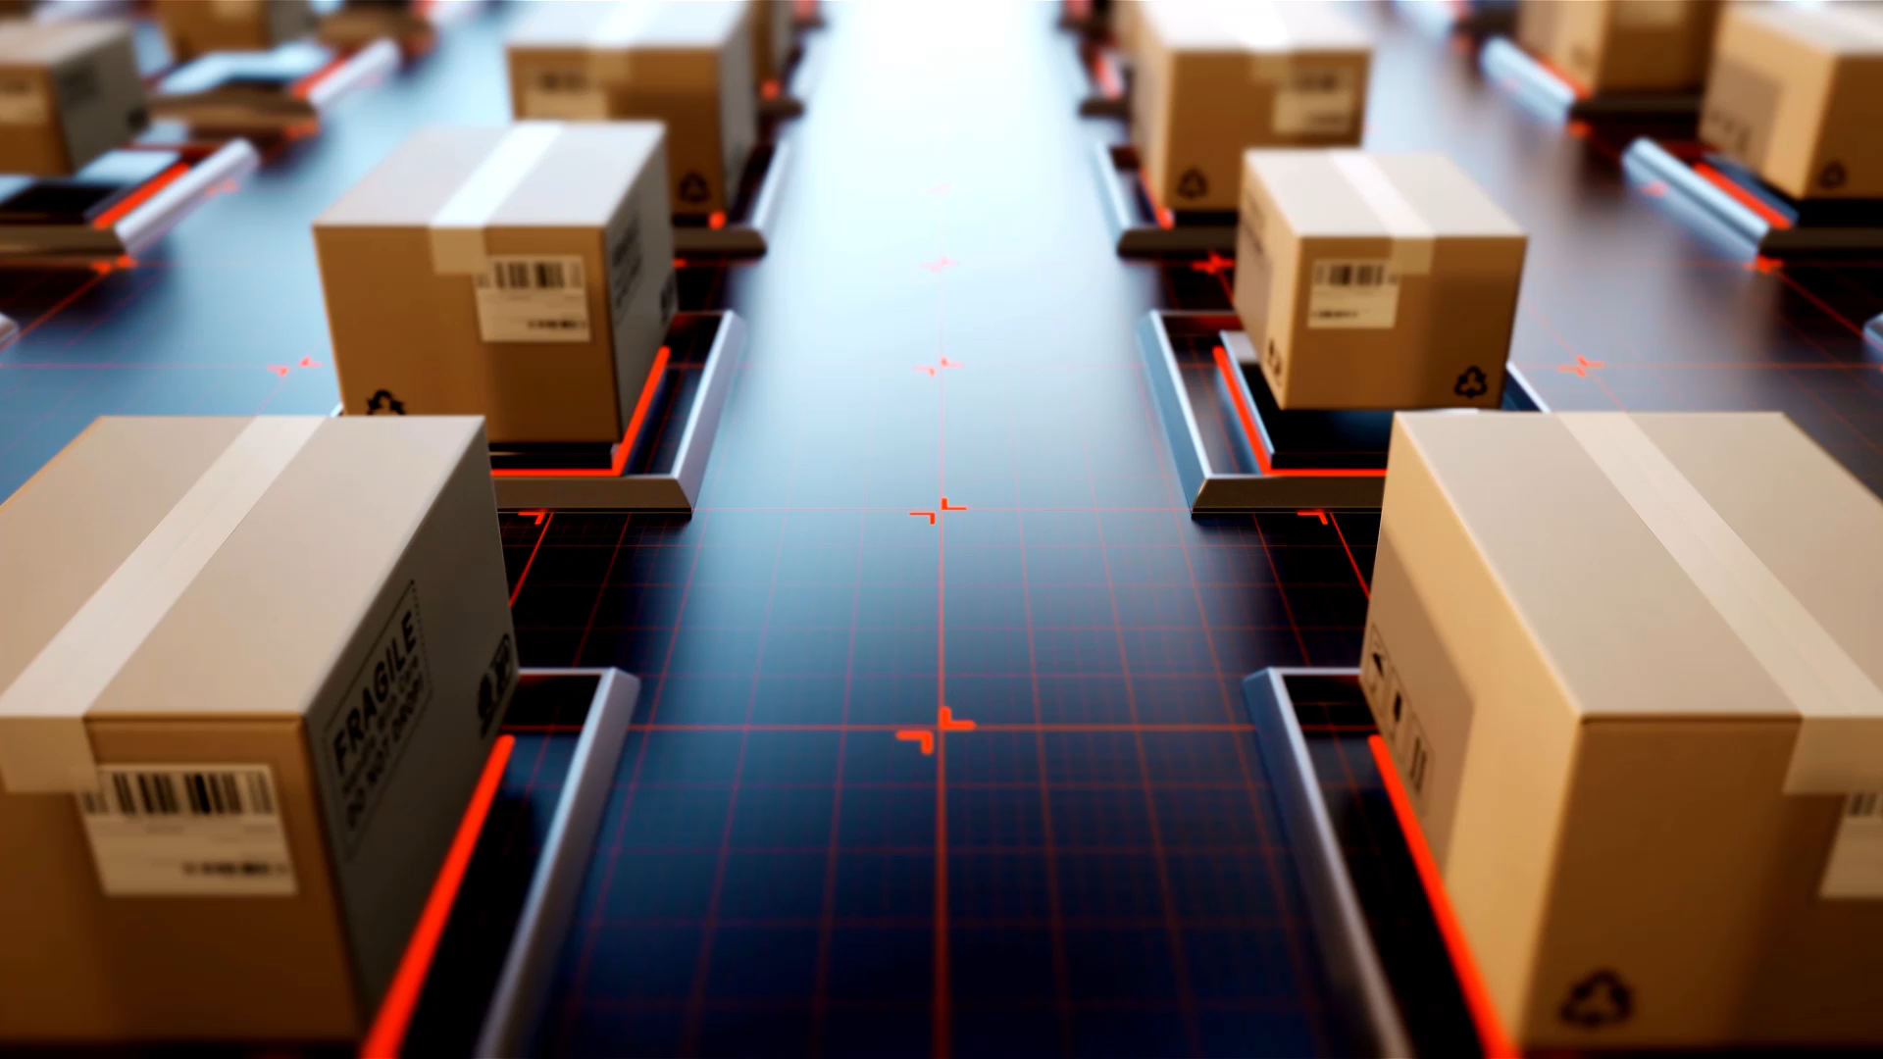
ASD-Project E-SHOP
Awai Iftikhar – 614184

Slide 2

Project Idea
Created Online Shopping WEB Application. And we used Spring Boot framework for Backend.

Slide 3

Use-cases
As a customer
I should be able to browse shop
categories, so that I can find the product I
want easily.
As a customer
I should be able to view the product
details, so that I can see the product
(Price, Details).
As a customer
I should be able to add product, so that I
can view the product in my shopping cart.
As a customer
I should be able to view my shopping
cart, so that I can see the already added products.
As a customer
I should be able to update the shopping cart, so that I can add/remove products to it.
As a customer
I should be able to view the total order cost, so that I can review how much I will pay.
As a customer
I should should be able to cancel order. (not ready yet)
As a customer
I should be able to checkout order (not ready yet).

Slide 4





Architecture & Software Developing Methodology
Database : MySQL
GitHub as version control
Maven
Layered Architecture
Back-End: Spring Boot

Slide 5
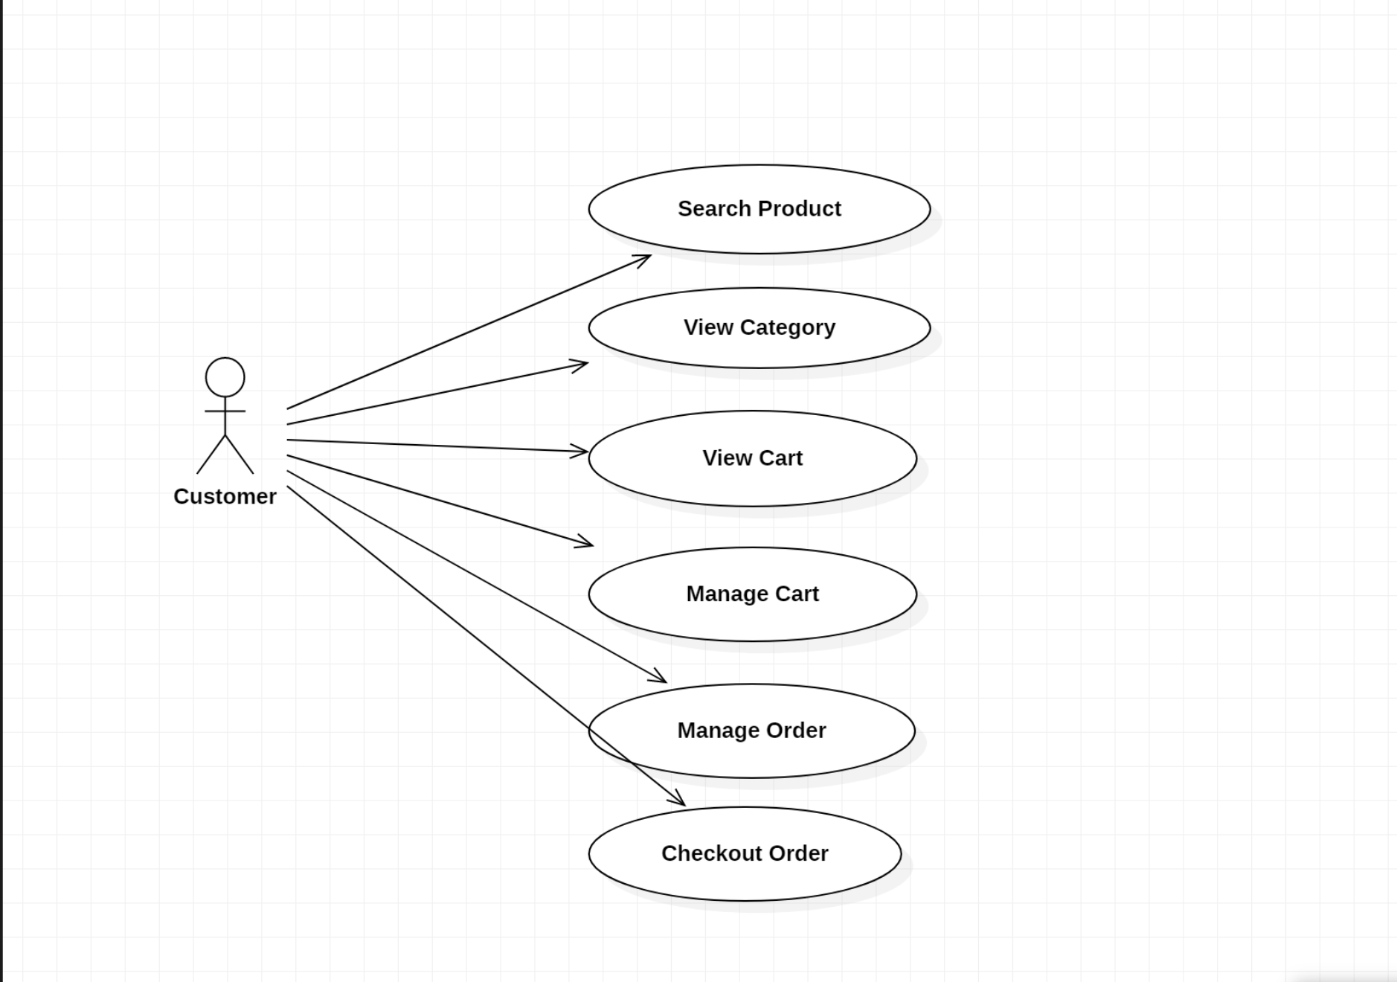
Use-Case Diagram

Slide 6
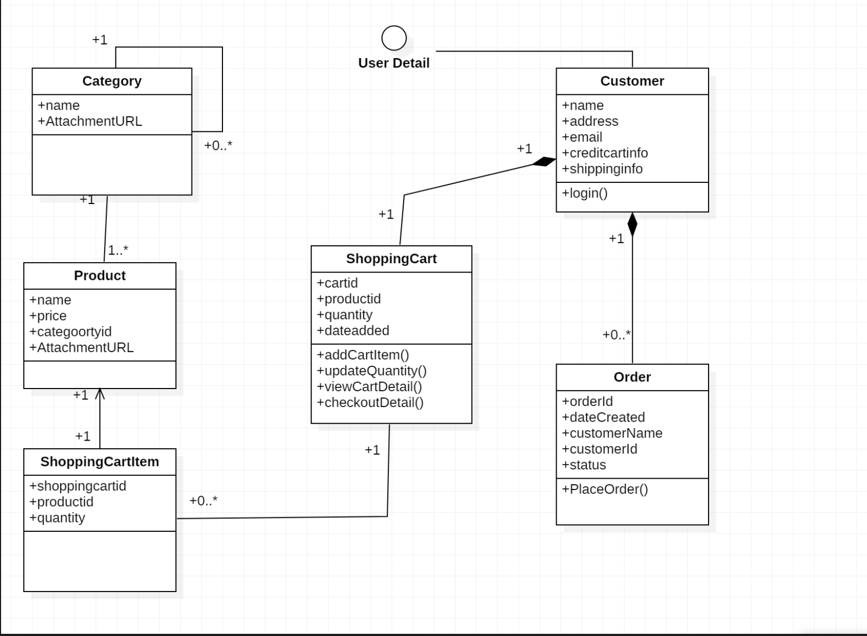
Class Diagram

Slide 7
Demonstration.

